Slide 1
Make sure to take good notes and keep up with them. You will use them on a notes test that we will take once I’ve finished the presentation.

Slide 2
What comes to mind when you hear the word “Southern”?

Slide 3
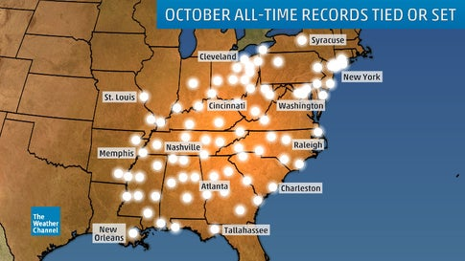
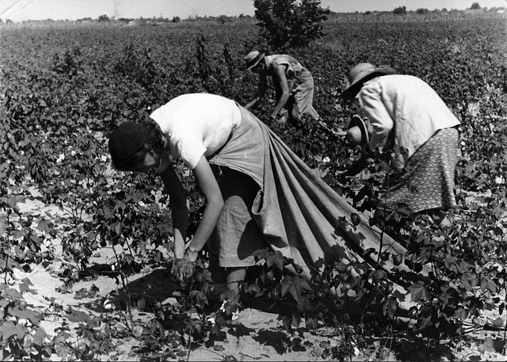
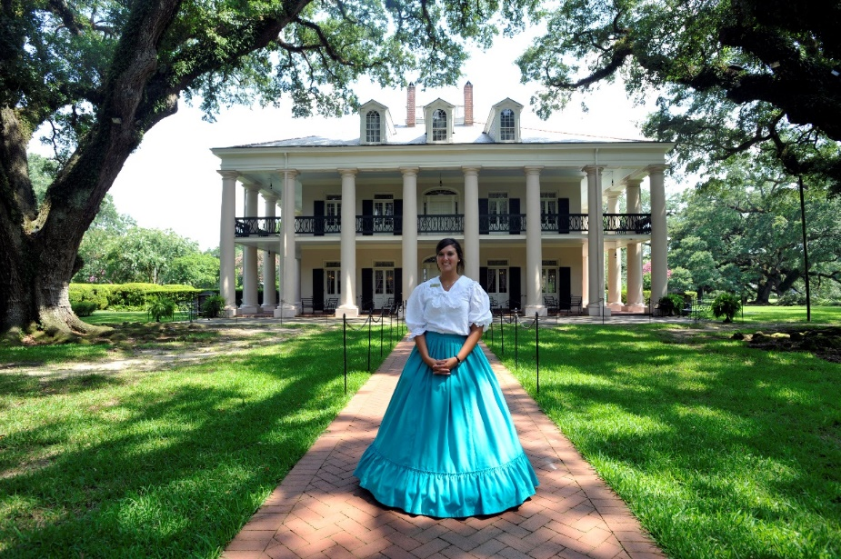

Slide 4
We know that being Southern is more than just being born in an area. It means identifying with certain values, traditions, and expectations that make us who we are. It’s a part of our identity.
But where did this identity come from? More about that later…

Slide 5
What comes to mind when you hear the word “goth”?

Slide 6
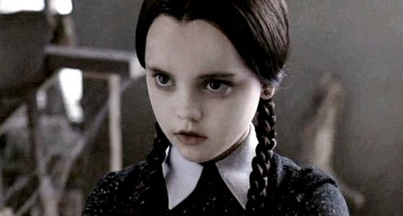
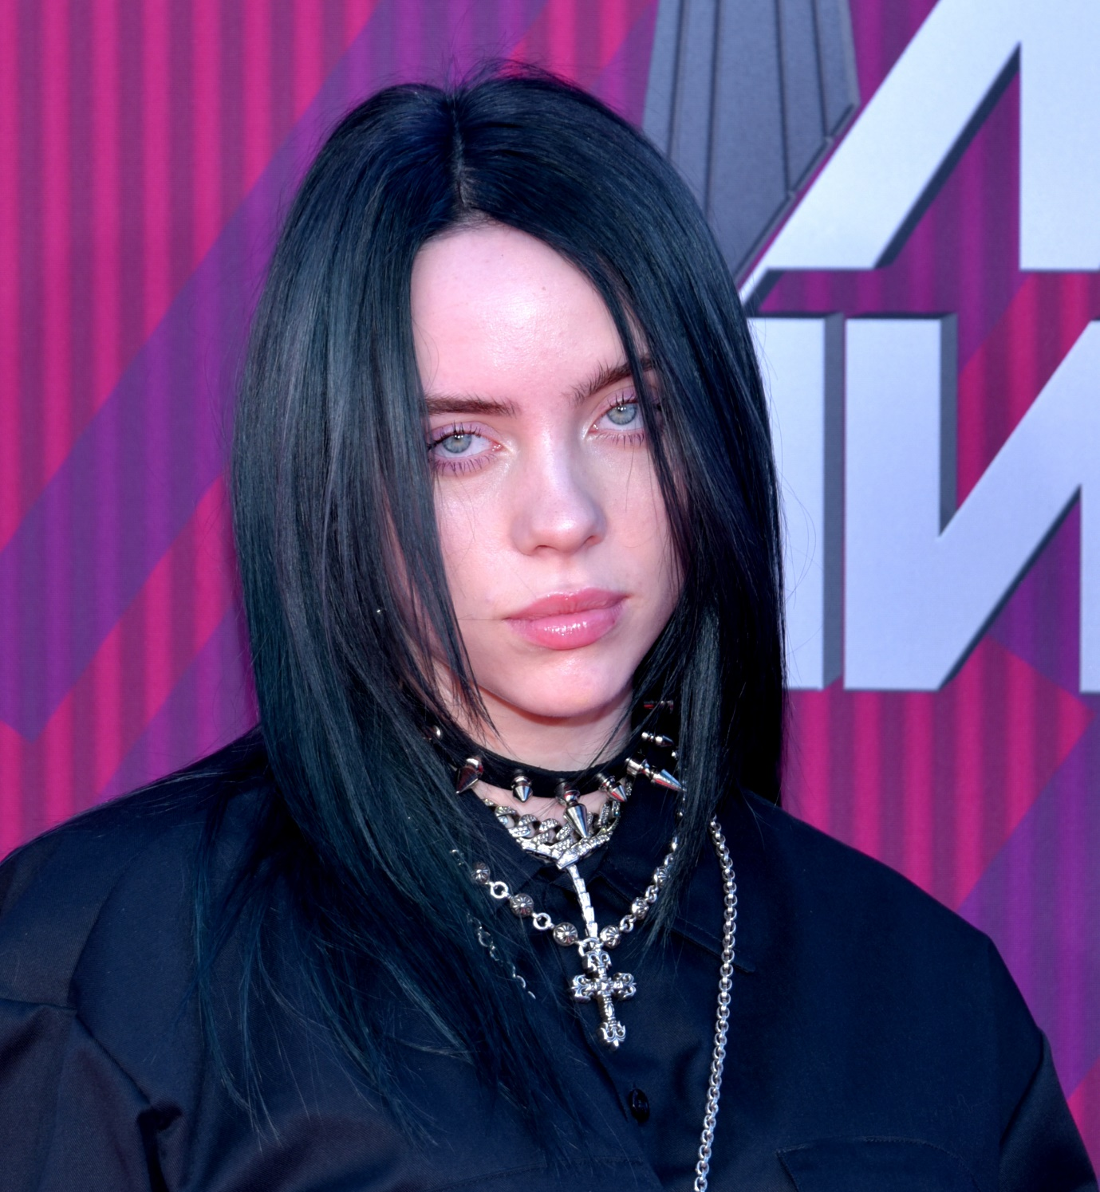
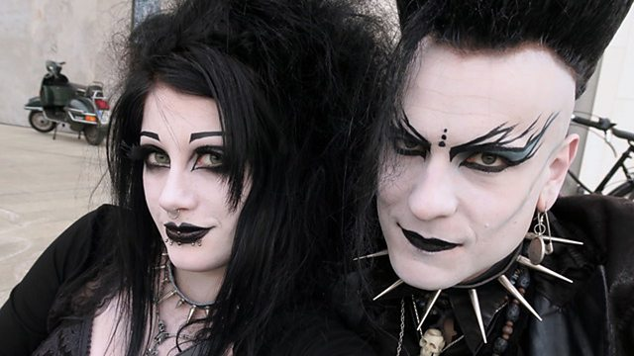

Slide 7
“Baby Shark”- Slay Duggee
BABY SHARK (Heavy Metal) by SLAY DUGGEE - YouTube

Slide 8
“Sound of Silence”- Disturbed
Disturbed - The Sound of Silence [LYRICS] - YouTube

Slide 9
Put them together, and you’ve got…

Slide 10
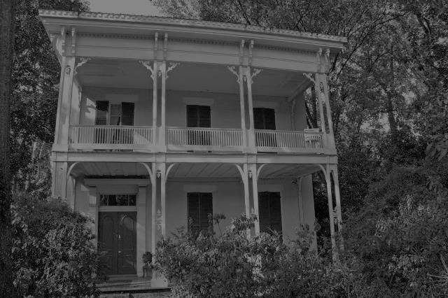
Southern Gothic (Literature)

Slide 11
Southern Gothic literature takes the darkest elements of “Gothic” and makes them distinctly Southern.

Slide 12
Give it a shot in your character journal!

Slide 13
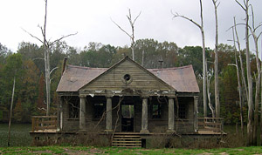
I was walking through the woods one day when I walked up on this run-down shack. I walked up to the open window and saw… (Finish the story. Make sure to write at least six-seven sentences.)

Slide 14
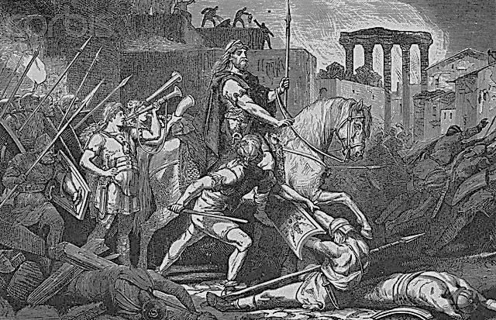
Background on Gothic Literature
The terms “Goth” and “Gothic” were originally used to describe the Germanic tribes (Visigoths) that pilfered and plundered across Europe from the 3rd to 5th centuries.

Slide 15
Background on Gothic Literature
Think Vikings… sort of.

Slide 16
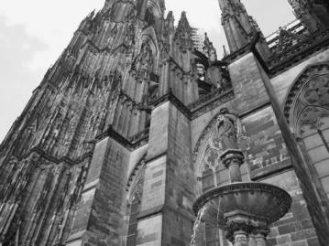
The architecture from the 12th to the 16th centuries is called “gothic.”
It is characterized by pointed arches and flying buttresses.
Think about where it’s pointing.

Slide 17
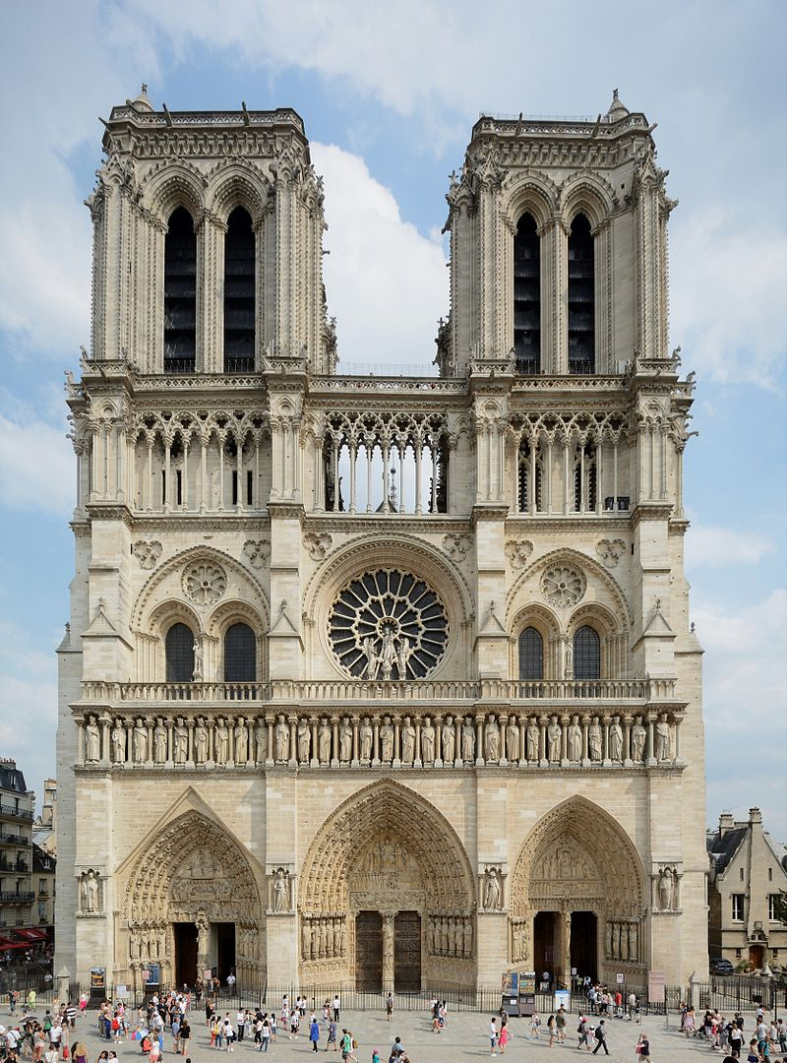
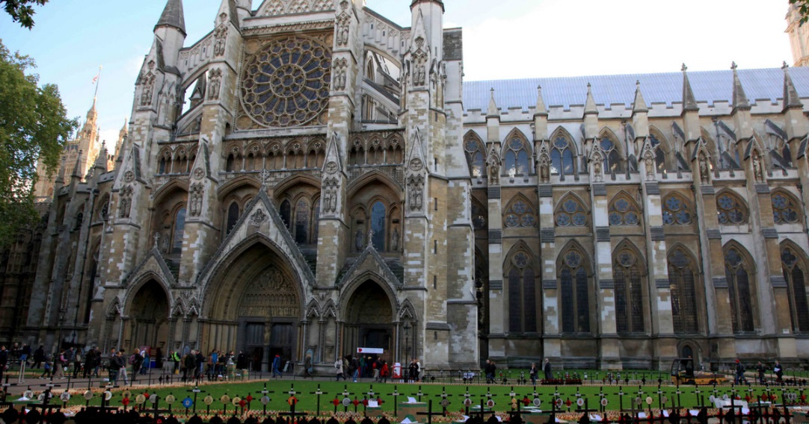
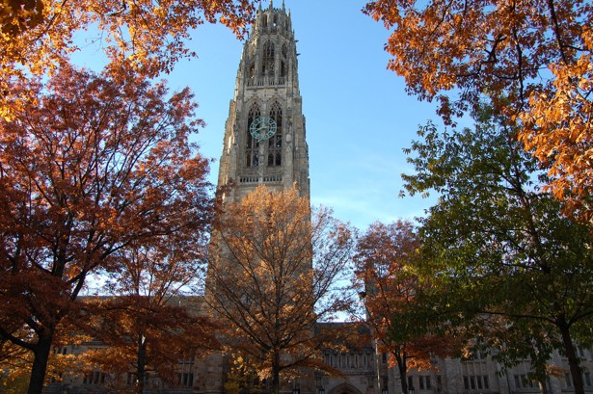
Westminster Abbey
Notre Dame
Harkness Tower

Slide 18
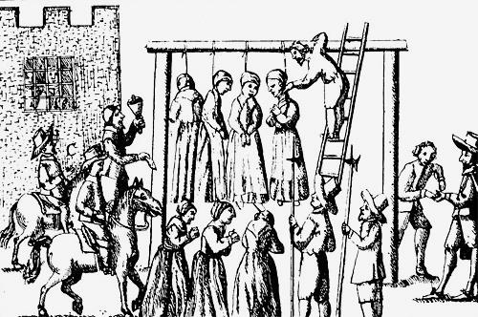
In 18th century England, the term “gothic” then became synonymous with Middle Ages, like the architecture; it was a period of chaos and superstition. This is when the term took on a darker connotation.

Slide 19
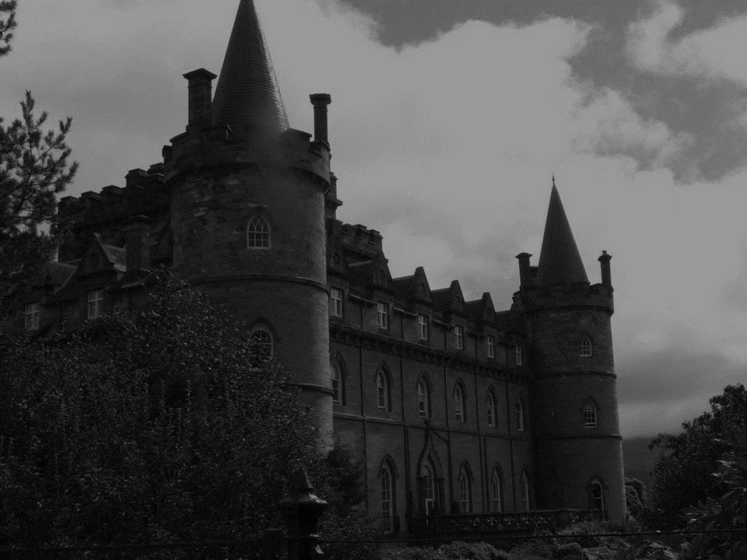
The Castle of Otranto
The newest form of entertainment in the late 1700s was the novel, the form of which Horace Walpole used to write the first example of Gothic literature in 1764: The Castle of Otranto.

Slide 20
Watch this…
Horror Bits 011 - The Castle of Otranto - YouTube

Slide 21
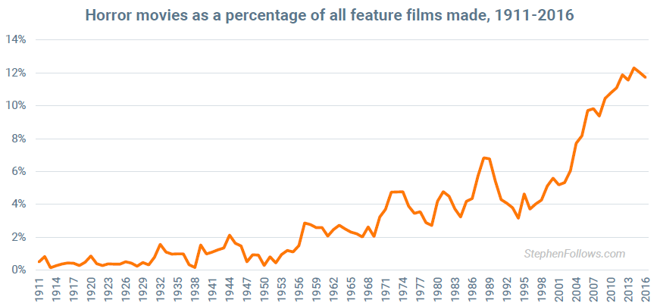
Of course, people are drawn to the macabre, or something that is dark and scary, even today.

Slide 22
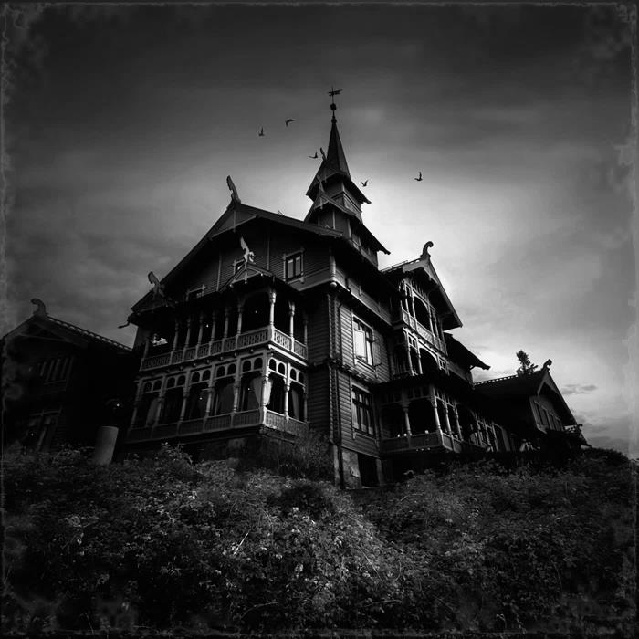
Tropes of Gothic Literature
A trope is something that is common to DIFFERENT STORIES in the same genre.
Like >>>
Gloom and doom setting – mysterious castles, dungeons, frightening forests, labyrinths, secret passages, cemeteries, mist and fog
Ambiguous heroes and villains – neither
absolutely good nor absolutely evil
Often involves an ancestral
curse and family secrets

Slide 23
Tropes of Gothic Literature
These are tropes because they always carry the same connotations (the emotional effect that something has on the audience).

Slide 24
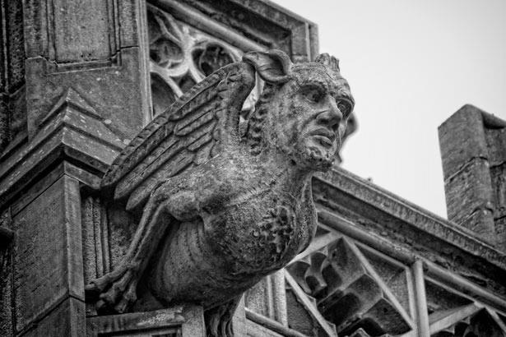
Common Motifs
A motif is a symbol, a character, or a theme that occurs over and over again IN THE SAME STORY.

Slide 25
Common Motifs
Revenge
Decay
Transformation
Superstitions
Grave robbing
Mystery
Nightmares/dreams
Necromancy
Pursued female
Unreliable narrator

Slide 26
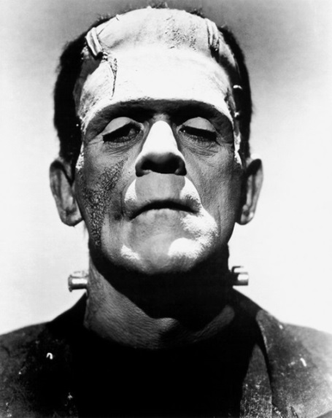
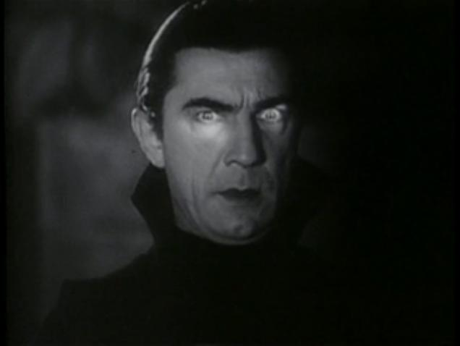
Famous Gothic Literature
Frankenstein by Mary Shelley 1818
Dracula by Bram Stoker 1897

Slide 27
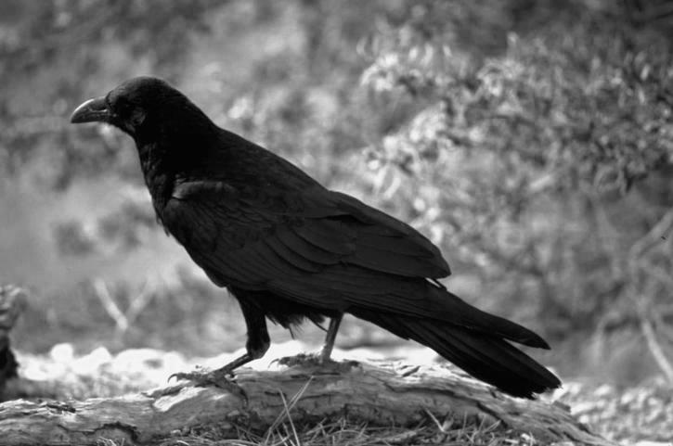
Gothic Literature Comes to America
Whereas traditional gothic literature most often took the novel form, American writers like Edgar Allan Poe and Nathaniel Hawthorne wrote short stories.

Slide 28
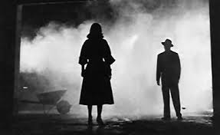
Southern Gothic Literature
Southern Gothic literature turns the tropes of traditional gothic literature, such as the hero and the monster, into American Southerners.
It focuses on their moral and social shortcomings of damaged, even delusional characters.

Slide 29
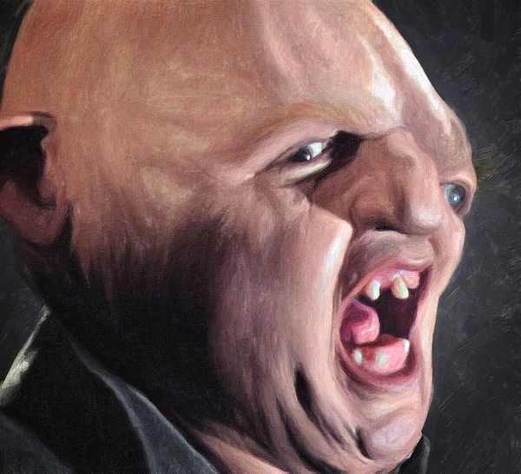
Characteristics of Southern
Gothic Literature
“Grotesque” – This term can include situations and places as well as deeply flawed, disturbing characters who often exhibit anti-social behavior while simultaneously invoking feelings of sympathetic pity. In other words, the author wants you
to be repulsed by the character before
realizing that you are just like him or her.

Slide 30
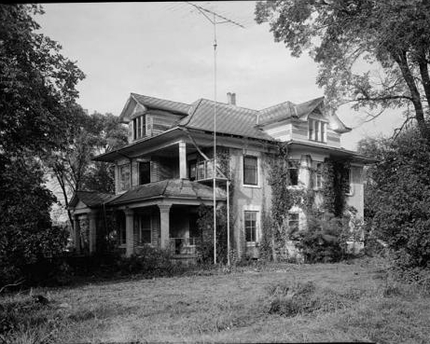
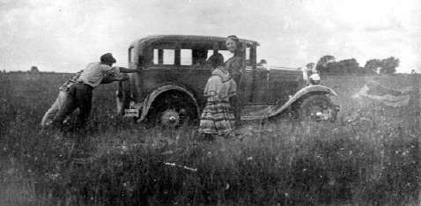
More Characteristics
Strong sense of place
Hyperbolic events
Nostalgia for past
Broken or unusual physical objects
Outsiders become heroes
Dark humor
Sense of supernatural
Generational decay

Slide 31
The Quiz
Watch this Bugs Bunny cartoon and tell me five “gothic” characteristics you see in it. Remember, characterization is when an author gives characters or stories certain familiar traits that cause you to be more invested into them.
Example of “gothic” characteristics (you should write ones like this)
1. “Nightmares/Dreams”- In the beginning of the movie, Bugs Bunny can’t sleep because he is having a nightmare, which is what causes him to see the female bunny robot.

Slide 32
Gothic Literature Comes to America
Bugs Bunny- Hair-Raising Hare

Slide 33
Southern Gothic (Literature)

Slide 34
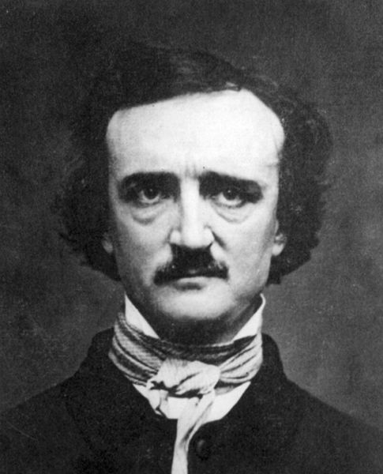
Edgar Allan Poe
1809-1849
Poe is considered the father of the modern detective story and the architect of the modern short story.
Southern gothic literature began with Poe. He changed the gothic genre by focusing on the psychology of the characters rather than supernatural events.

Slide 35
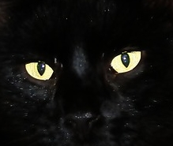
Some of Poe’s
Most Famous Works
“The Cask of Amontillado”
“The Pit and The Pendulum”
“The Masque of the Red Death”
“The Fall of the House of Usher”
“The Tell Tale Heart”
“The Raven”
“Annabelle Lee”

Slide 36
“The Raven”- Classic (watch this)
The Raven (Christopher Lee) - YouTube

Slide 37
“The Raven”- Pop Culture- watch this
The Simpsons - Edgar Allan Poe: The Raven - YouTube

Slide 38
Facts About Poe
Born in Boston, Massachusetts on 01/19/1809
Orphaned by age 3
Grew up in Richmond, VA, with foster parents
1825 entered U.V.A. but left later due to gambling debts and lack of money
1827 Enlisted in U.S. Army under name of Edgar A. Perry
Attended West Point, court-martialed and kicked out in 1831 because of his substance abuse (alcohol and laudanum)
Married 14-year-old cousin Virginia Clemm
Died 10/07/1849

Slide 39
Theories on the Cause of Poe’s Death
Alcoholism
Lesions on the brain
Tuberculosis
Epilepsy
Rabies
Mugging
“Cooping”–During elections, gangs kidnapped innocent people and held them in a room called a “coop.” The victims were forced to visit polls, voting again and again. The gangs plied the victims with liquor and beat them to insure cooperation.

Slide 40
Poe’s Grave
Poe’s body was originally placed in an unmarked grave. On 11/17/1875, his body was moved and a monument dedicated. Three people are buried underneath it – Poe, his wife, and his Aunt.
Poe Toaster – Beginning in 1949 and continuing until 2009, on the night of the anniversary of Poe’s death, a mysterious stranger left a partial bottle of cognac and three roses on Poe’s grave.

Slide 41
Watch this…
Edgar Allan Poe : Legend of The Poe Toaster - YouTube

Slide 42
William Faulkner
William Faulkner didn’t graduate from high school or college, lived in a small town in the poorest state in the nation during the Great Depression, faced financial ruin, and still managed to write multiple novels set in the imaginary world of Yoknapatawpha County, Mississippi, that resulted in his becoming one of the most acclaimed writers of the 20th Century.
From the Carl Van Vechten collection

Slide 43
Watch this…
William Faulkner - Two Time Pullitzer Prize Winner & Poet-Novelist of Mississippi | Mini Bio | BIO - YouTube

Slide 44
Timeline of Faulkner’s Life
Born 9/25/1897 in New Albany, Mississippi
1918 joined British Royal Flying Corp
1924 published a book of poetry, The Marble Faun
1925 published first novel, Soldier’s Pay
1930 married Estelle Oldham
1929-1933 The Sound and the Fury, Sanctuary, As I Lay Dying, Light in August
1933 daughter Jill born
1932-1945 screenplays
1936 Absalom, Absalom!
1949 Won Nobel Prize
Died 07/06/1962

Slide 45
Interesting Facts About Faulkner
Supported himself as a postmaster at the University of Mississippi but was fired for reading on the job
Was a notorious ladies man
Declined a dinner invitation to the White House, saying it was “a long way to go just to eat.”
Wrote a short-story collection of crime fiction called A Knight’s Gambit

Slide 46
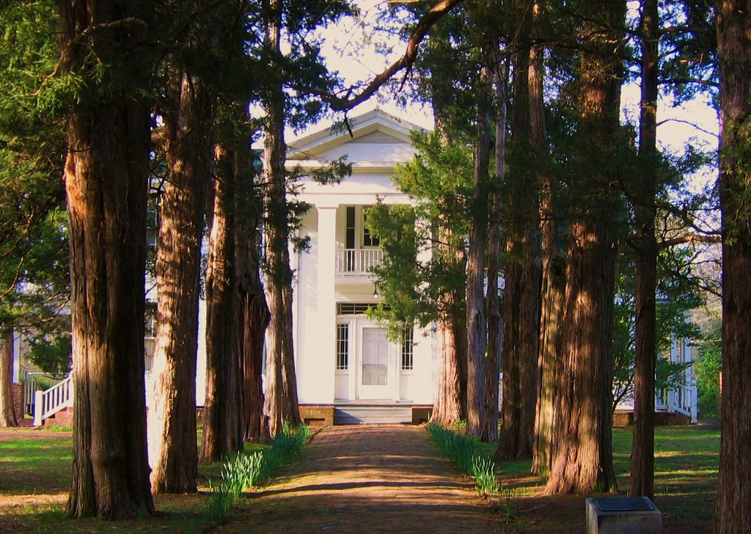
Rowan Oak- Oxford, MS

Slide 47
Faulkner’s writing, filled with the sights, sounds, and smells of the South and populated with vivid, unforgettable characters examines the distinctive frame of mind of the people in that place and time.
Yet, his characters are universal in their struggle with what he called in his Nobel Prize speech, “the old verities and truths of the heart…love and honor and pity and pride and compassion and sacrifice.”

Slide 48
Flannery O’Connor
Flannery O’Connor, considered one of America’s greatest writers, produced only two short novels, two collections of short stories, and a number of essays and letters. A staunch Catholic and an
unabashedly ardent believer, she wrote of marginalized people in unknown rural areas who encounter God’s grace in the face of grotesque events such as murder, bigotry, and madness. She called it “the action of grace in territory held largely by the devil.”

Slide 49
Flannery O’Connor- Watch this…
https://www.pbs.org/video/religion-ethics-newsweekly-flannery-oconnor/

Slide 50
Facts About Flannery O’Connor
Born 03/25/1925 in Savannah, Georgia
Graduated 1945 from Georgia State College for Women and in 1947 from University of Iowa
1952 First novel Wise Blood
Her personal symbol was a peacock -funny-looking and awkward yet transfigured when it showed its tail, it’s most unique and striking feature.
Believed racism was the curse of the South and a failure by white Christians
Died of Lupus 08/03/1964

Slide 51
“A Good Man Is Hard to Find”
Audio Reading
https://www.youtube.com/watch?v=hrGq07Vs848

